Slide 1
Mixin Design Pattern
Mixins are classes that offer functionality that can be easily inherited by a sub-class or group of sub-classes for the purpose of function re-use.
Mixins allow objects to borrow (or inherit) functionality from them with a minimal amount of complexity. Thus, Mixins can be viewed as classes with attributes and methods that can be easily shared across a number of other classes.
@ShankaragoudaG

Slide 2
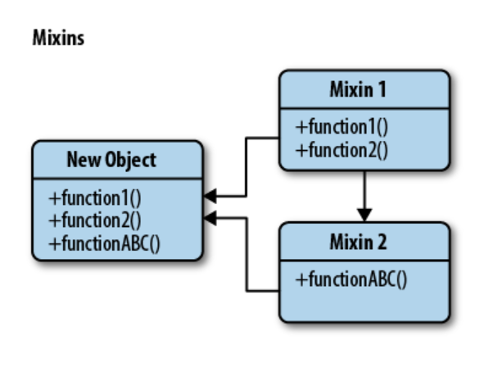
Mixin Pattern Diagram

Slide 3
Mixin Pattern - ES5/Classic
In classic JavaScript, each new object we define has a prototype from which it can inherit further properties. Prototypes can inherit from other object prototypes but, even more importantly, can define properties for any number of object instances.
We can easily extend the prototype of existing constructor functions to include this behavior using a helper such as the Underscore.js _.extend() method.
Thus, using classic JavaScript, we have a fairly flexible way to share functionality from not just one Mixin, but effectively many through multiple inheritance.

Slide 4
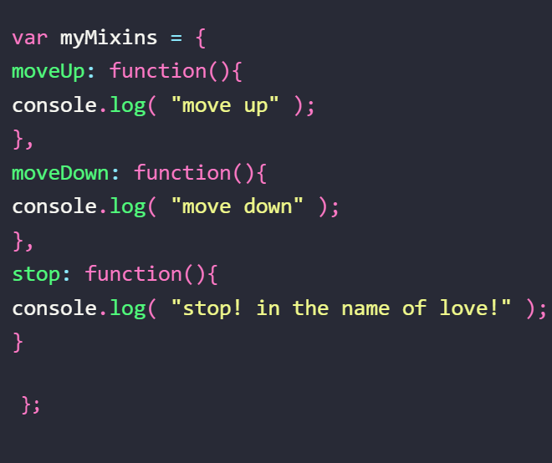
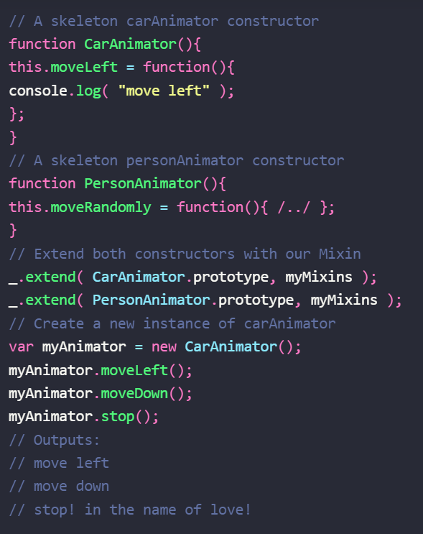
Example
Creating a Mixin
Extending a Mixin

Slide 5
Advantages
Mixins assist in decreasing functional repetition and increasing function re-use in a system.
Where an application is likely to require shared behavior across object instances, we can easily avoid any duplication by maintaining this shared functionality in a Mixin and thus focusing on implementing only the functionality in our system which is truly distinct.

Slide 6
Disadvantages
Some developers feel that injecting functionality into an object prototype is a bad idea as it leads to both prototype pollution and a level of uncertainly regarding the origin of our functions.

Slide 7
Useful Resources
https://www.oreilly.com/library/view/learning-javascript-design/9781449334840/ch09s13.html
https://www.c-sharpcorner.com/article/learn-about-mixin-pattern/

